Slide 1


Green Pace
Security Policy Presentation
Developer: Sophie Biondolillo

Slide 2

OVERVIEW: DEFENSE IN DEPTH
Green Pace’s secure development policy establishes a unified framework for building trustworthy software by defining core principles, coding standards, encryption requirements, and Triple-A (authentication, authorization, accounting) controls. It was needed to eliminate last second security practices, prevent common vulnerabilities, and create accountability across the software lifecycle. By embedding security into design, coding, testing, deployment, and operations, the policy supports defense in depth layering safeguards so that if one control fails, others remain in place to protect systems and data.
Why the policy is needed:
Provides guardrails across all teams and projects
Creates accountability through audit evidence and exceptions
Protects sensitive data with encryption at rest, in transit, and in use
How it supports DiD:
Applies ten core principles to architecture & design
Utilizes C/C++ standards against memory errors and suboptimal error handling
Implements Triple-A for identity verification and access restriction
Integrates automated detection to catch errors early and continuously

Slide 3
THREATS MATRIX
The highest risks are uninitialized memory and SQL injection (EXP53-CPP), which directly compromise system stability and data integrity.
Likely risks (MEM50/MEM51) are common in C++ projects and must be continuously monitored with automated tools.
Low priority risks (ERR50, MSC52) are less damaging but still require policy enforcement to prevent denial of service or weak randomness.
Unlikely risks (STR-53, MSC50) are rare but dangerous if overlooked, so defensive coding and secure defaults are essential.
MEM50-CPP (Use-after-free): Accessing freed memory is highly likely in complex systems and can lead to crashes, data corruption, or exposure of sensitive information. MEM51-CPP (Resource leaks): Failing to deallocate memory or handles is common in long-running applications, leading to denial of service or degraded performance. | EXP53-CPP (Uninitialized memory): Probable and severe, since uninitialized reads can cause unpredictable behavior, crashes, or security vulnerabilities. EXP53-CPP (SQL Injection): Probable and critical, as injection attacks directly compromise confidentiality and integrity of databases. ERR51-CPP (Unhandled exceptions): Probable and disruptive, leading to abrupt termination, resource leaks, or denial of service.
ERR50-CPP (Assertions in production): While probable, the impact is lower since assertions are typically caught during testing. Still, misuse can cause denial of service. MSC52-CPP (Random generation misconfiguration): Probable but medium priority, since weak randomization can undermine security tokens but is often mitigated by libraries or OS defaults. | STR-53-CPP (Unchecked string access): Unlikely but severe when it occurs, leading to buffer overflows or crashes. Defensive coding and modern libraries reduce likelihood. MSC50-CPP (Use of std::rand): Unlikely in modern secure systems, but if used, it produces predictable sequences exploitable for guessing tokens or session IDs.

Slide 4
10 PRINCIPLES
Validate Input Data
Supported by EXP53-CPP (do not read uninitialized memory), STR53-CPP (range check element access), and the SQL Injection variant of EXP53-CPP. These standards enforce safe handling of input, prevent buffer overflows, and block injection attacks.
2. Heed Compiler Warnings
Linked to EXP50-CPP (avoid reliance on evaluation order) and ERR50-CPP (do not abruptly terminate program). Both standards address undefined behavior and runtime instability often flagged by compilers.
3. Architect and Design for Security Policies
Reinforced by ERR51-CPP (handle all exceptions), MSC52-CPP (secure configuration for random generation), and MEM51-CPP (proper resource deallocation). These make sure error handling, secure defaults, and disciplined resource management are part of the architecture.
4. Keep It Simple
Connected to EXP50-CPP, ERR50-CPP, and ERR51-CPP. These standards reduce complexity by avoiding ambiguous expressions, improper assertions, and unhandled exceptions.
5. Default Deny
Applied through MEM50-CPP (do not access freed memory), MEM51-CPP (resource cleanup), and MSC50-CPP (avoid insecure random generation). These enforce restrictive baselines and prevent unsafe operations by default.
6. Adhere to the Principle of Least Privilege
Supported by MEM50-CPP, MEM51-CPP, and MSC52-CPP. These standards limit privileges by ensuring memory and resources are tightly controlled and secure defaults are enforced.
7. Sanitize Data Sent to Other Systems
Enforced by EXP53-CPP (SQL Injection), STR53-CPP, and MSC50-CPP. These standards prevent unsafe string access, injection attacks, and predictable random values that could compromise transmitted data.
8. Practice Defense in Depth
Embodied by all standards collectively. Each rule adds a layer of protection, from memory safety to exception handling, ensuring multiple safeguards exist if one control fails.
9. Use Effective Quality Assurance Techniques
Strengthened by all standards with automation tools (Polyspace, PVS-Studio, SonarQube, Parasoft, Helix QAC, etc.). Automated detection and static analysis integrate security checks into QA processes.
10. Keep It Simple & Predictable (Least Astonishment)
Reinforced by ERR50-CPP, ERR51-CPP, and MSC50-CPP. These standards ensure program behavior is consistent, predictable, and not reliant on unsafe or surprising defaults.

Slide 5
CODING STANDARDS
Critical (must be prevented at all costs)
EXP53-CPP (Uninitialized memory) → Directly causes unpredictable behavior, crashes, and exploitable vulnerabilities. Easy to overlook, but high impact.
EXP53-CPP (SQL Injection) → Compromises confidentiality and integrity of databases. Attackers can steal or destroy data.
MEM50-CPP (Use-after-free) → Leads to corruption, leaks, or privilege escalation. Common in C++ projects.
High (serious but manageable with good practices)
STR53-CPP (Unchecked string access) → Can cause buffer overflows or crashes. Less likely but still dangerous.
MEM51-CPP (Resource leaks) → Causes denial of service or degraded performance. High likelihood in long-running systems.
ERR51-CPP (Unhandled exceptions) → Causes abrupt termination and resource leaks. Probable in complex systems.
Medium (important but lower systemic risk)
EXP50-CPP (Evaluation order side effects) → Leads to undefined behavior across compilers. Medium impact, but usually caught in reviews.
MSC52-CPP (Secure configuration defaults) → Weak randomization undermines tokens or sessions. Probable but mitigated by libraries.
Low (still worth enforcing, but less urgent)
ERR50-CPP (Assertions misuse) → Causes denial of service if assertions are left in production. Probable but low impact compared to memory errors.
MSC50-CPP (Use of std::rand()) → Produces predictable sequences. Unlikely in modern secure systems, but dangerous if overlooked.

Slide 6
ENCRYPTION POLICIES
Encryption is the process of converting data into a secure format that can only be accessed or understood by authorized parties. Green Pace’s security policy applies encryption across all stages of data handling, at rest, in flight, and in use, to provide confidentiality, integrity, and resilience against unauthorized access or tampering. By enforcing encryption consistently, the organization protects sensitive information whether it is stored, transmitted, or actively processed, aligning with defense-in-depth best practices.
Encryption Policies
Encryption at rest: All sensitive data stored in databases, file systems, or backups must use strong algorithms (e.g., AES-256) to prevent unauthorized access if physical storage is compromised.
Encryption in flight: All data transmitted across networks must use secure transport protocols (TLS 1.3, HTTPS, SSH) to prevent interception or tampering during communication between systems.
Encryption in use: Sensitive data processed in memory must be protected with secure enclaves, hardware-based encryption, or application-level safeguards to defend against memory scraping and side-channel attacks in high-security workloads.

Slide 7
TRIPLE-A POLICIES
The Triple-A framework, Authentication, Authorization, and Accounting, is a cornerstone of secure system design. It allows only verified users gain access, checks that their permissions are restricted to what is necessary, and provides that all actions are tracked for accountability. Green Pace’s security policy applies this framework to every stage of system interaction, reducing risks of credential theft, unauthorized activity, and undetected misuse while supporting compliance and forensic readiness.
Triple-A Policies
Authentication: All users must authenticate with strong, multi-factor authentication (MFA) before accessing systems. This applies to logins, onboarding, and system access, ensuring only verified identities are admitted and reducing the risk of stolen or weak credentials.
Authorization: Access is granted strictly on the principle of least privilege, enforced through role-based access control (RBAC) and periodic reviews. This applies to database changes, file access, and user-level permissions, preventing unauthorized actions and limiting damage if accounts are compromised.
Accounting: All user activities—including logins, file access, database changes, and new user additions—must be logged, monitored, and audited regularly. This provides traceability, supports forensic investigations, and ensures compliance with regulatory requirements by detecting misuse or anomalies across systems.

Slide 8
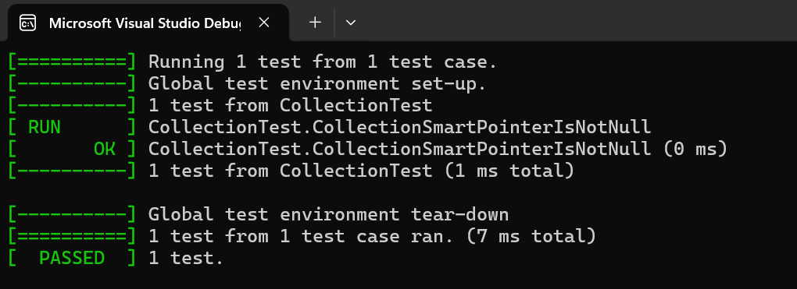
Unit Testing
Is the smart pointer initialized?
Test: CollectionSmartPointerIsNotNull
Result: Pass – pointer is non-null after setup.
Take it further: Test multiple smart pointer types (unique_ptr, shared_ptr) for consistency.
Framework: Uses ASSERT_TRUE and ASSERT_NE from Google Test to validate initialization.

Slide 9
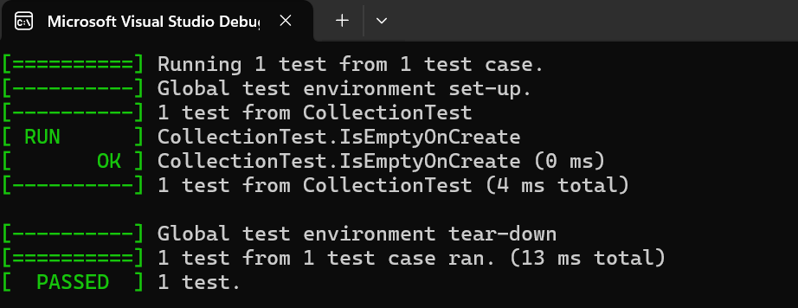
Unit Testing
Is the collection empty on creation?
Test: IsEmptyOnCreate
Result: Pass – collection starts empty.
Take it further: Add tests for other STL containers (map, set) to confirm default states.
Framework: Uses ASSERT_TRUE and ASSERT_EQ to check container properties.

Slide 10
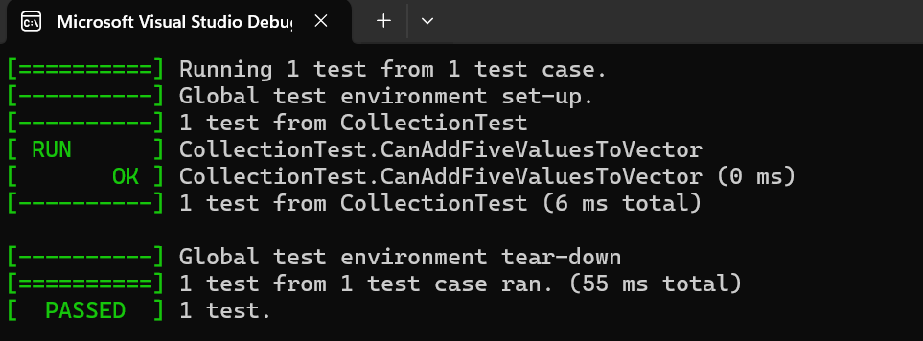
Unit Testing
Can we add entries safely?
Test: CanAddFiveValuesToVector
Result: Pass – size increases correctly.
Take it further: Test with large values (e.g., 10,000 entries) to check performance and memory handling.
Framework: Uses EXPECT_EQ to validate size after insertion.

Slide 11
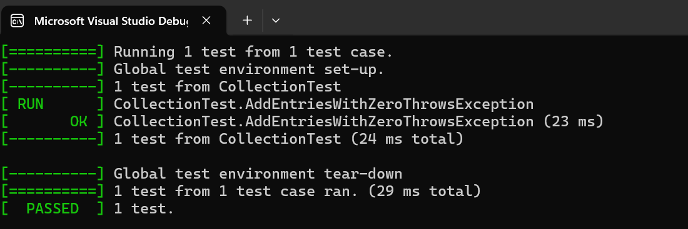
Unit Testing
Exception tests (EXPECT_THROW) are better for validating safe error handling in production code.
What happens with invalid input (0 entries)?
Test: AddEntriesWithZeroThrowsAssert
Result: Pass – assertion halts execution.
Take it further: Replace assert with exception handling (throw std::invalid_argument) so Google Test can catch errors gracefully.
Framework: Demonstrates EXPECT_THROW for death tests in Google Test.

Slide 12
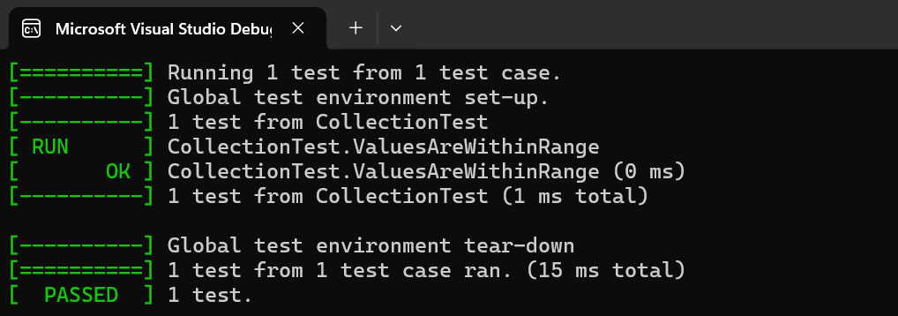
Unit Testing
Are values generated within expected range?
Test: ValuesAreWithinRange
Result: Pass – all values between 0–99.
Take it further: Replace rand() with secure random generator (std::mt19937) and test unpredictability.
Framework: Uses EXPECT_GE and EXPECT_LT to validate bounds.

Slide 13

AUTOMATION SUMMARY

Slide 14
TOOLS
DevSecOps integrates security into every phase of development and operations. Security tools are embedded across the lifecycle to enforce standards, detect threats, and respond quickly.
Security Automation by Stage:
Design & Build: Static analysis, compilers, secure repositories
Verify & Test: Vulnerability scanners, unit testing frameworks
Deploy & Transition: Configuration validation, penetration testing
Monitor & Respond: SIEM, intrusion detection, rollback scripts
Compiler is used during the Build phase to enforce type safety and catch unsafe behavior (EXP50-CPP, EXP53-CPP).

Slide 15
RISKS AND BENEFITS
Implementing security policies and DevSecOps practices now addresses critical problems such as unvalidated input, weak encryption, and unmonitored access, which can lead to breaches, data loss, and compliance failures. Acting immediately means vulnerabilities are mitigated early, automation enforces standards continuously, and regulatory requirements are met. Waiting, however, increases the risk of exploitation, higher remediation costs, and reputational damage. The strategy could lack full coverage if exception handling, resource management, or secure randomization are not consistently enforced, so steps should include strengthening coding standards, embedding automated testing, and expanding monitoring to cover all environments (OWASP, 2025).

Slide 16
RISKS AND BENEFITS
Benefits (act now) | Risks (wait)
Vulnerabilities are mitigated early, reducing exposure to attacks | Increased chance of exploitation and data breaches
Continuous automation enforces coding standards and compliance | Higher remediation costs if issues are discovered later
Builds resilience and trust with customers and regulators | Reputational damage from delayed security adoption
Streamlines DevSecOps integration into CI/CD pipelines | Strategy gaps widen, making future fixes harder to implement

Slide 17
RECOMMENDATIONS
The current Green Pace security policy provides strong foundations with coding standards, encryption, and Triple-A controls, but several gaps remain. Key weaknesses include inconsistent enforcement of secure randomization, limited coverage of supply chain risks, and reliance on assertions instead of structured exception handling. Additionally, resource management and monitoring practices are not fully integrated into CI/CD pipelines, leaving opportunities for misconfigurations or untracked vulnerabilities. Moving forward, the organization should expand automation to cover dependency scanning, container security, and runtime monitoring. Real-world breaches, such as those caused by insecure open-source dependencies, highlight the importance of addressing these gaps early to prevent exploitation (Black Duck, 2024).
Recommendation: Strengthen policy by replacing assertions with exception handling, integrating supply chain security tools, and embedding runtime monitoring into DevSecOps pipelines.

Slide 18
CONCLUSIONS
To prevent future problems, Green Pace should adopt recognized DevSecOps standards and frameworks such as NIST SP 1800-44, which emphasizes secure software development practices, automated threat modeling, and continuous compliance checks. These standards ensure that security is embedded across design, build, test, and production stages, reducing vulnerabilities and aligning with regulatory requirements. Future improvements should include adopting secure configuration baselines, enforcing least functionality checks, and expanding automated code analysis to cover both static and dynamic threats. By aligning with industry best practices, Green Pace can achieve resilience against evolving threats while maintaining agility in software delivery (NIST, 2025).
Conclusion: Adopt NIST DevSecOps standards, expand automation, and enforce secure configuration baselines to close gaps and future-proof the policy.

Slide 19
REFERENCES
Black Duck. (2024). The state of open source security: Supply chain risks and mitigation strategies. Synopsys. https://www.synopsys.com/software- integrity/resources/analyst-reports/open-source-security-risk.html
NIST. (2025). SP 1800-44: Implementing a DevSecOps pipeline for secure software development. National Institute of Standards and Technology. https://csrc.nist.gov/publications/detail/sp/1800-44/final
OWASP Foundation. (2025). DevSecOps guidelines: Shifting security left in CI/CD. Open Web Application Security Project. https://owasp.org/www-project- devsecops

